Slide 1

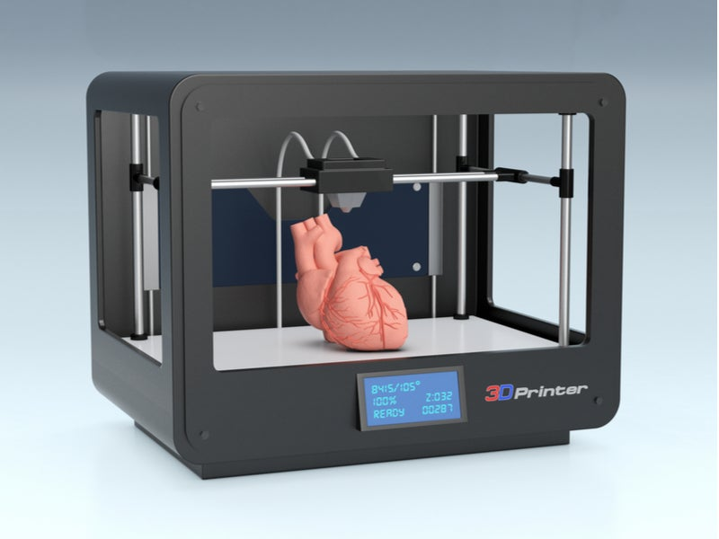
Process optimization: 3D Bioprinting
CAS ADS M3 project
Romain Topalian
24/11/2022

Slide 2
Summary
Context
Description of the study
Description of the data
Distribution of the data
Linear regression
Polynomial regression
Random forest regressor/Support vector regression
Conclusion and outlook

Slide 3
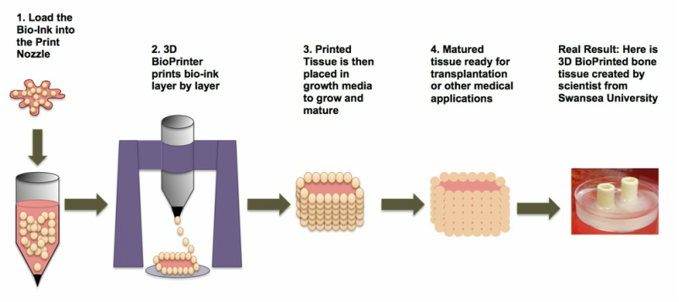
Context
3D Bioprinting: from cell to organs
http://www.3ders.org/articles/20140306-research-into-3d-bioprinting-may-soon-produce-transplantable-human-tissues.html

Slide 4
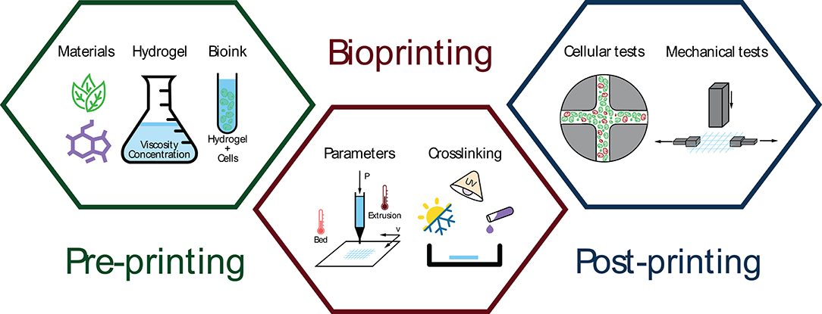
Context
3D Bioprinting: a compliated process involving many parameters
Mancha Sánchez E, Gómez-Blanco JC, López Nieto E, Casado JG, Macías-García A, Díaz Díez MA, Carrasco-Amador JP, Torrejón Martín D, Sánchez-Margallo FM, Pagador JB. Hydrogels for Bioprinting: A Systematic Review of Hydrogels Synthesis, Bioprinting Parameters, and Bioprinted Structures Behavior. Front Bioeng Biotechnol. 2020 Aug 6;8:776. doi: 10.3389/fbioe.2020.00776. PMID: 32850697; PMCID: PMC7424022.

Slide 5
Description of the study
A dataset of 617 instances corresponding to a unique cell viability value was collected from 75 different scientific papers about 3D Bioprinting.
48 parameters (columns) have been created in order to describe each experiment.
The aim is to build a model to find out which parameters are relevant and how to optimize the 3D Bioprinting process by means of regression model

Slide 6
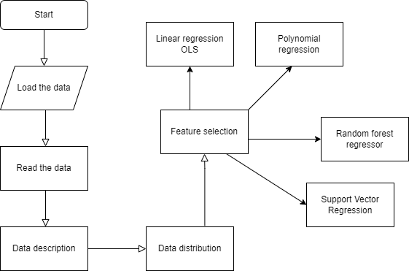

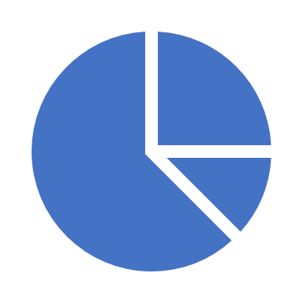
Data flow:
Dataset: OSF | Machine Assisted Experimentation of Extrusion-based Bioprinting Systems
Regression model

Slide 7
Description of the data
48 Features:
Inputs |  |  | Output
Bioink formulation | Bioprinter parameters | Cell parameters | Cell viability
617 studies (scientific articles) were compiled.
The categorical value are transformed in numerical (method dummies)
A global view of data can be done with the function describe, mean, median, standard deviation or interquartile range.
Aim is to find the best printing conditions for highest cell viability.

Slide 8
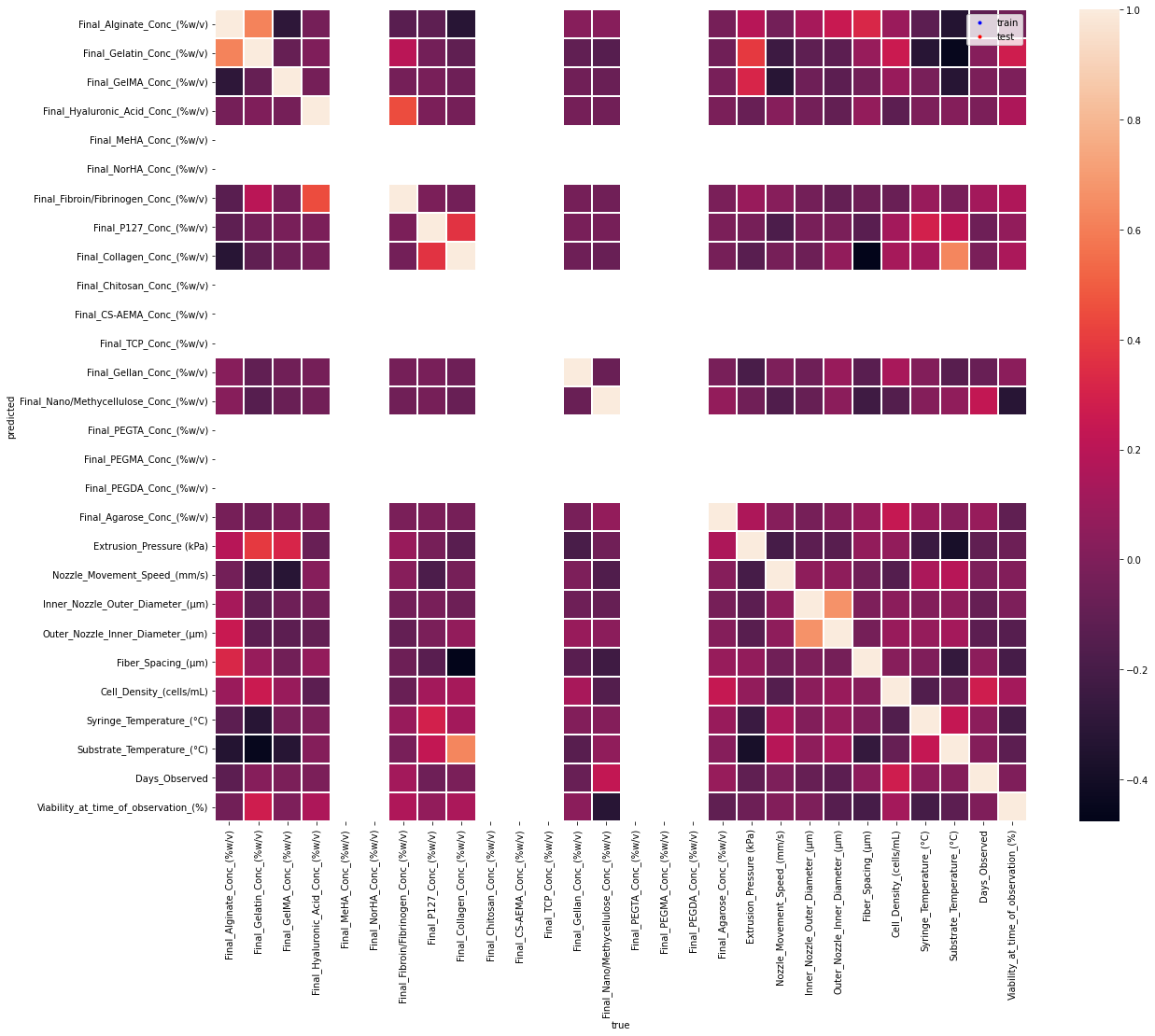
Description of the data
Correlation matrix

Slide 9
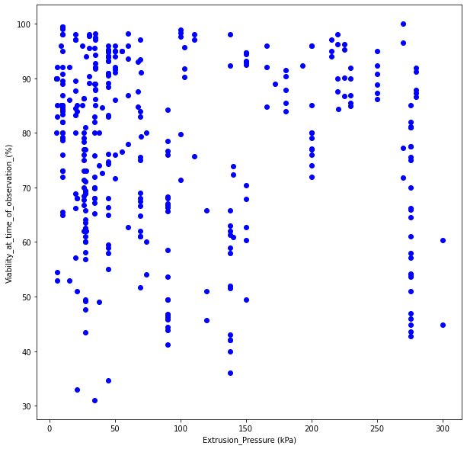
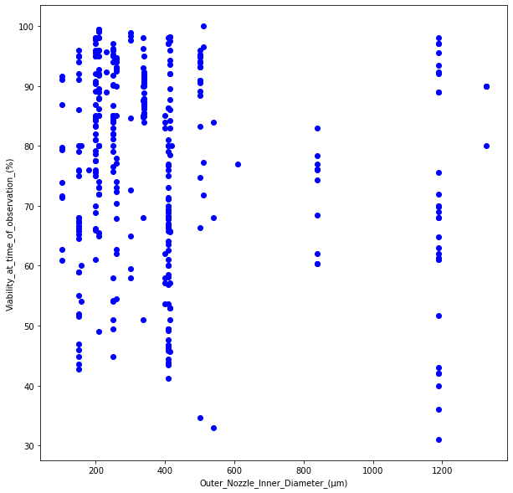
Description of the data

Slide 10
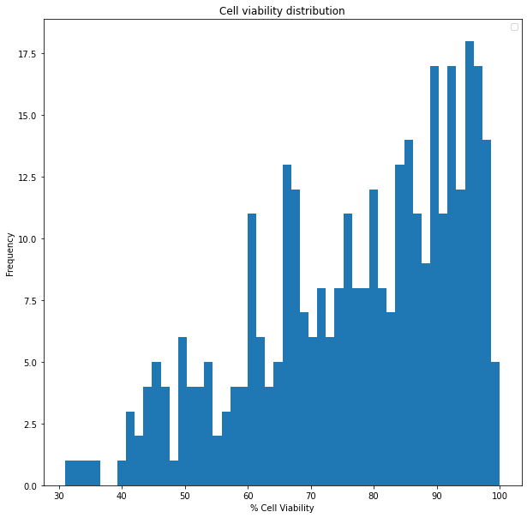
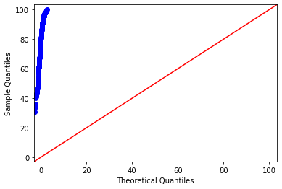
Distribution of the data
Q-Q plot
D’Agostino-Pearson Test: The null hypothesis is rejected=> no normal distribution (α=0,001)

Slide 11
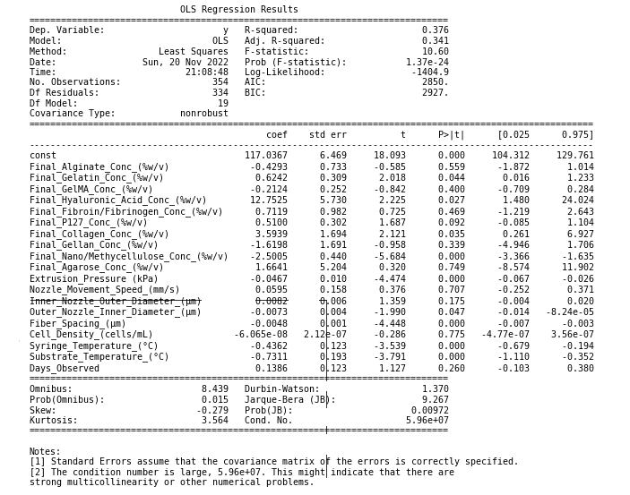
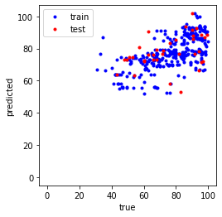
Linear Regression
Multiple Linear Regression
OLS
R²= 0.1
train R² = 0.4
test R² = 0.1
train MSE = 12.4
test MSE = 15.8

Slide 12
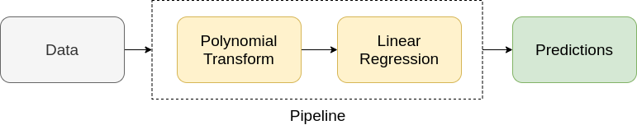
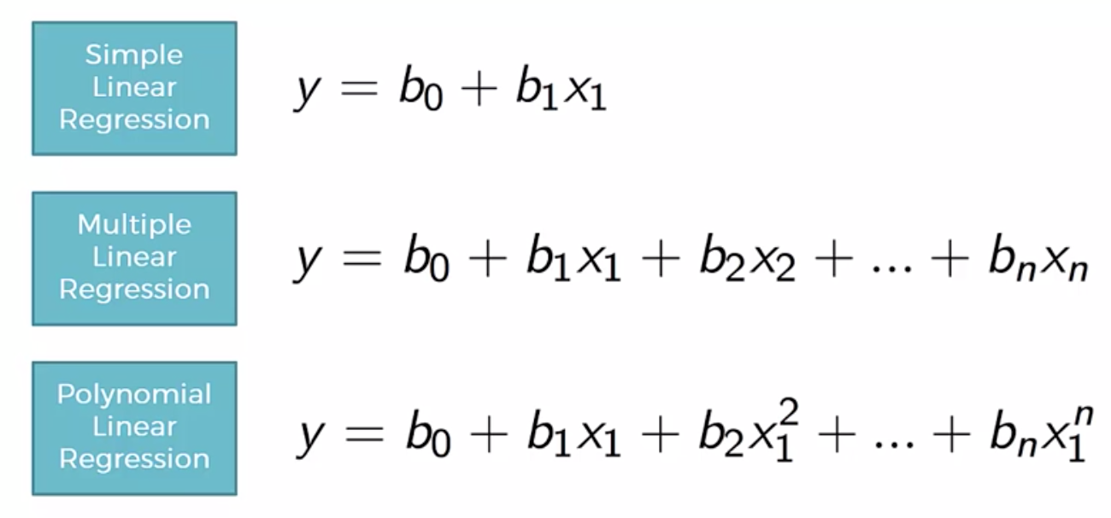
Multivariate Polynomial Linear Regression
Degrees:
n=1 =>Linear regression: RMSE=14.28
n=2 => Polynomial regression: RMSE=733
n=3=> RMSE=1326
n=4=> RMSE=5818

Slide 13
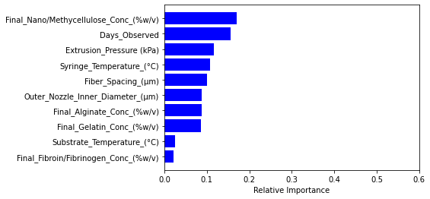
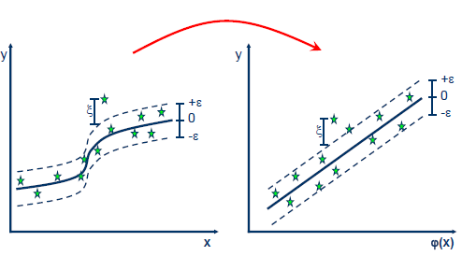
Random forest Regressor
Support vector regression
10 most important features
R²: 0.4844
RMSE: 12.147
MSE: 336.06
R²: -0.17

Slide 14
Conclusion and outlook
Data on 3D Bioprinting studies => description and distribution
Linear Regression, OLS, polynomial regression, random forest regressor, support vector regression
Need more data? Neural network?
Classification?

Slide 15
